Slide 1
SMART FASHION RECOMMENDER APPLICATION
TEAM MEMBERS
SUJI PRIYA R(TEAM LEAD)
SELVANAYAKI G
VINOTHINI M
SHAILESH B
MENTORS
INDUSTRY MENTOR : KRISHNA CHAITANYA
FACULTY MENTOR : M.VENGATESHWARAN

Slide 2
ABSTRACT
Fashion is perceived as a meaningful way of self-expressing that people use for different purposes. It seems to be an integral part of every person in modern societies, from everyday life to exceptional events and occasions. Fashionable products are highly demanded, and consequently, fashion is perceived as a desirable and profitable industry. Although this massive demand for fashion products provides an excellent opportunity for companies to invest in fashion-related sectors, it also faces different challenges in answering their customer needs.

Slide 3
PROBLEM STATEMENT
The personal information collected by recommenders raises the risk of unwanted exposure of that information. Also, malicious users can bias or sabotage the recommendations that are provided to other users. In recent years, the textile and fashion industries have witnessed an enormous amount of growth in fast fashion. On e-commerce platforms, where numerous choices are available, an efficient recommendation system is required to sort, order, and efficiently convey relevant product content or information to users.

Slide 4
LITERATURE SURVEY
Existing Methodologies
In existing system only simple web application and their rating has been implemented in existing system, An ecommerce product recommendation engine is a piece of technology that displays recommended products to shoppers throughout your store. It uses machine learning to get smarter and show increasingly relevant products to shoppers based on their interests. In existing model is content based filtering scheme has been employed in existing model .

Slide 5
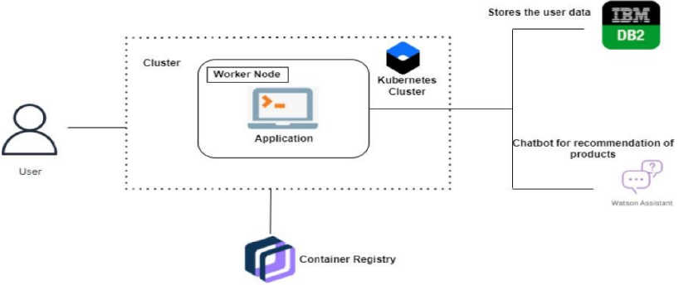
Proposed Architecture
We have come up with a new innovative solution through which you can directly do your online shopping based on your choice without any search. It can be done by using the chatbot.

Slide 6
TECH STACK
Front-End : HTML, CSS, JAVASCRIPT
Back-End : Python, Flask
Database : IBM DB2
Micro services : Send Grid

Slide 7
MODULES
In this project we will be working on two modules :
1. Admin
2. User
Admin: The role of the admin is to check out the database about the stock and have a track of all the things that the users are purchasing.
User :The user will login into the website and go through the products available on the website. Instead of navigating to several screens , the user can directly talk to Chatbot regarding the products.

Slide 8
Features of Chatbot :
•Using chatbot we can manage user's choices and orders.
•The chatbot can give recommendations to the users based on their interests.
•It can promote the best deals and offers on that day.
•It will store the customer's details and orders in the database.
•The chatbot will send a notification to customers if the order is confirmed.
•Chatbot can also help in collecting customer feedback.

Slide 9
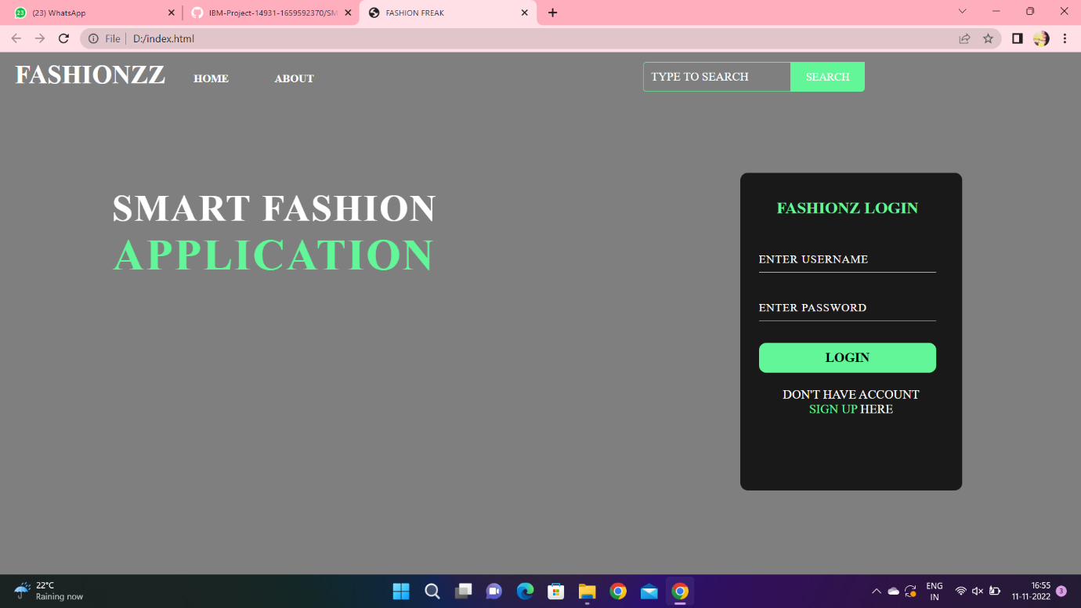
OUTPUT

Slide 10
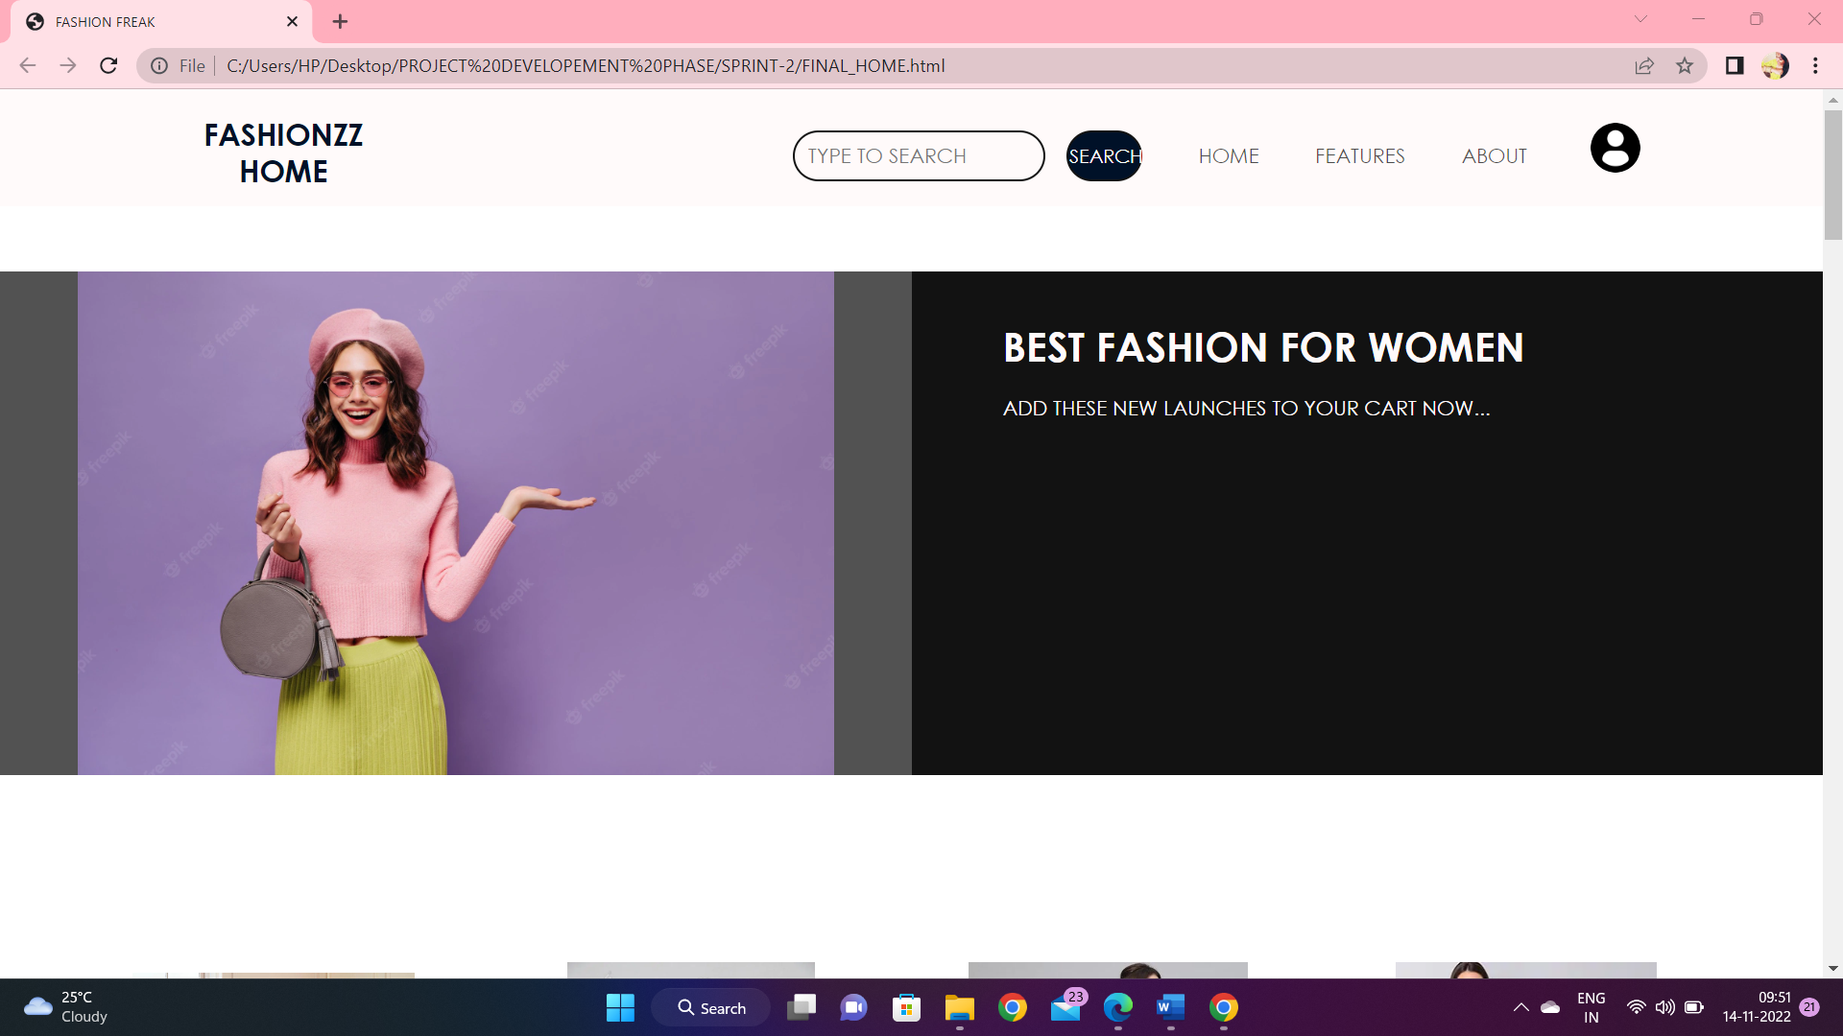

Slide 11
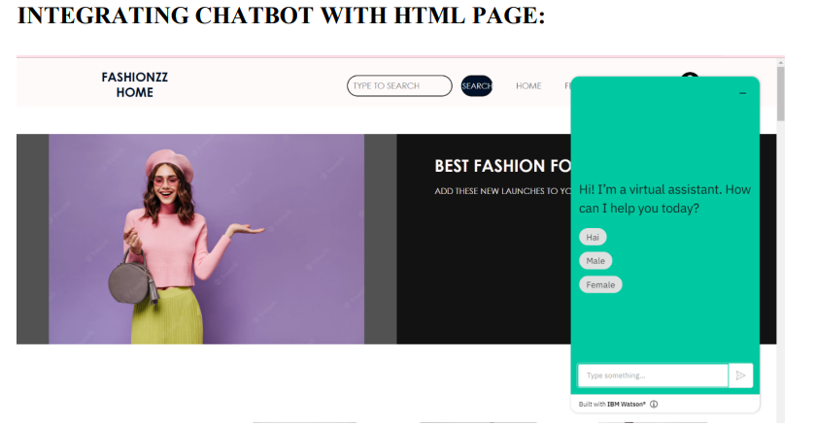

Slide 12
CONCLUSION
The Fashion Recommendation System is mainly used to recommend the best possible outfit combinations to a user who has no fashion sense based on their wardrobe . It may not always provide the best possible outfit to wear for an occasion as the system is dependent completely on the clothes present in the user’s wardrobe. Also another reason is that fashion is highly dependent on the time period. However the system does a great job in inculcating a fashion sense among the users and can provide the best recommendations based on the user’s wardrobe. Since the system is implemented as a website, it is very easy for the end users to access as well as use.

Slide 13
REFERENCE
GloablInfoResearch: Global Fast Fashion Apparel Market 2021 by Key Countries, Companies, Type and Application. GloablInfoResearch, Hong Kong, 2021.
Hoi, M., Wu, L., Chen, E., Li, Z., Zhen, V. W., & Liu, Q.: Explainable fashion recommendation: A semantic attribute region guided approach. In Proceedings of the 28th Twenty-Eighth International Joint Conference on Artificial Intelligence, 2019; pp. 4681- 4688.
O'Connell, L. (n.d). Topic: Apparel Market Worldwide. Retrieved August 30, 2020, from https://www.statista.com/topics/5091/apparel- market-worldwide/

Slide 14
Wang, H., Wang, N., & Young, D. Y.: Collaborative Deep Learning for Recommender Systems. In Proceedings of the 21th CM SIGKDD International Conference on Knowledge Discovery and Data Mining, New York, 2015; pp. 1235-1244.
McCauley, J., Target, C., Shi, Q., & Van Den Hegel, A.: Image-based Recommendations on Styles and Substitutes. In Proceedings of the 38th International ACM SIGIR Conference on Research and Development in Information Retrieval, 2015; pp. 43-52. 2015.

Slide 15


